Slide 1

Data Science Machine Learning Artificial Learning
Day - 14

Slide 2
Data Science
Data Science is a blend of various tools, algorithms, and machine learning principles with the goal to discover hidden patterns from the raw data.
The principal purpose of Data Science is to find patterns within data. It uses various statistical techniques to analyze and draw insights from the data.
A data scientist’s role combines computer science, statistics, and mathematics.
They analyze, process, and model data then interpret the results to create actionable plans for companies and other organizations.
Data scientists are analytical experts who utilize their skills in both technology and social science to find trends and manage data.
A data scientist’s work typically involves making sense of messy, unstructured data, from sources such as smart devices, social media feeds, and emails that don’t neatly fit into a database.
Experienced data scientists and data managers typically have over ten years of experience and are tasked with developing a company’s best practices, from cleaning to processing and storing data.

Slide 3
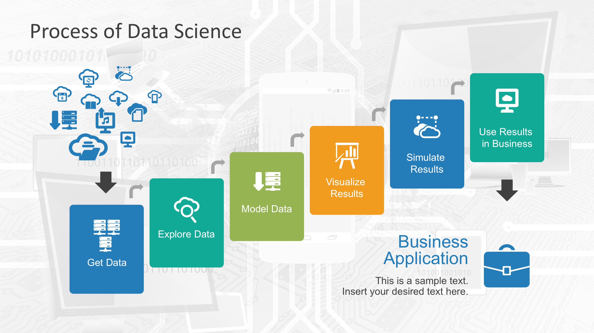

Slide 4

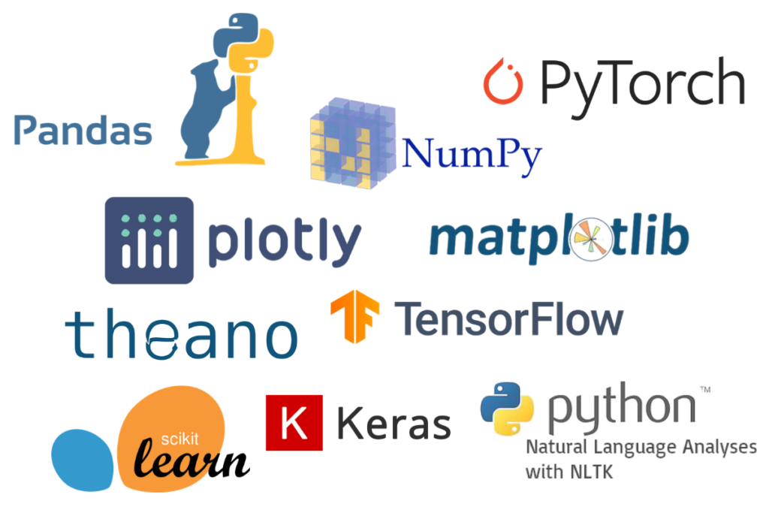
Machine Learning
Machine learning is an application of Artificial Intelligence.
As the name suggests, in machine learning, the system learns automatically from accessed data. Machines can take an algorithm and improve it and “learn” over time as they interact with more data. The more data it processes, the smarter the algorithm gets.
You don’t need to tell the Machine Learning Algorithms what to do and how to do it. Instead, you provide the algorithm with lots of examples and the algorithm learns from these examples.
To put it even more simply, Machine Learning is simply providing machines with the ability to “think”, “learn”, and “adapt”.
Machine learning algorithms build a mathematical model based on sample data, known as "training data", in order to make predictions or decisions to carry out human-like activities.

Slide 5

AI
Artificial Intelligence (AI) is the combined attribute of science and computer that makes the system or program, or any machines perform the Intelligent and Imaginative functions of a human, independently and solution to problems, be able to make decisions.
The main aim of Artificial Intelligence systems is to have the ability to discover, which makes people increase their performance and productivity over time.
Artificial Intelligent Technology tools include machine learning and deep learning which gives an analysis report to increase the clarity of planning, reasoning, thinking, problem-solving and learning.

Slide 6
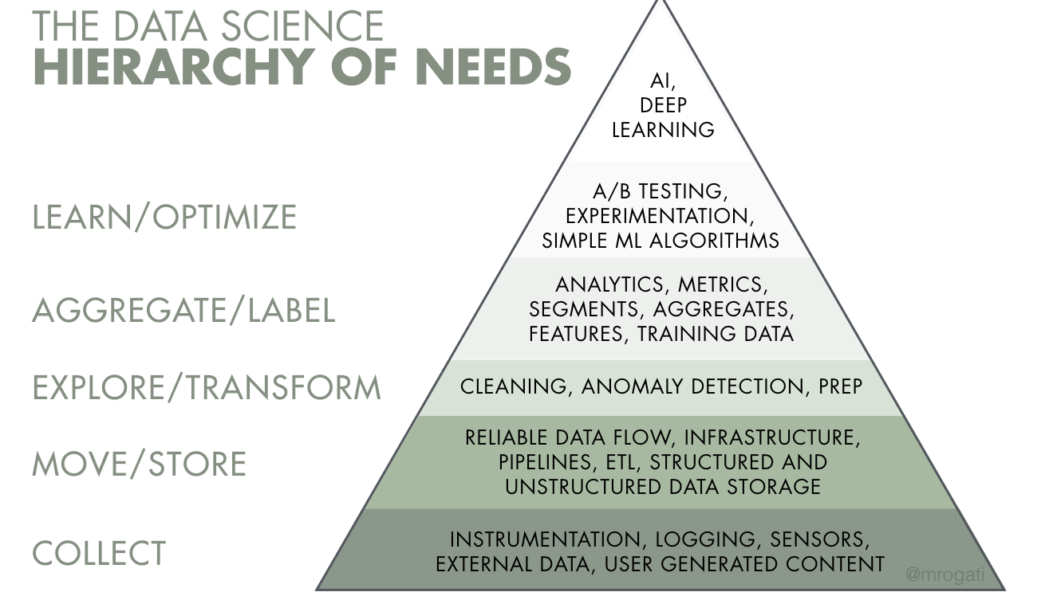

Slide 7
NumPy
NumPy is a Python library used for working with arrays.
It also has functions for working in domain of linear algebra, fourier transform, and matrices.
In Python we have lists that serve the purpose of arrays, but they are slow to process.
NumPy aims to provide an array object that is up to 50x faster than traditional Python lists.
The array object in NumPy is called ndarray, it provides a lot of supporting functions that make working with ndarray very easy.
Arrays are very frequently used in data science, where speed and resources are very important.

Slide 8
Matplotlib
Matplotlib is an amazing visualization library in Python for 2D plots of arrays. Matplotlib is a multi-platform data visualization library built on NumPy arrays and designed to work with the broader SciPy stack.
One of the greatest benefits of visualization is that it allows us visual access to huge amounts of data in easily digestible visuals.
Matplotlib consists of several plots like line, bar, scatter, histogram etc.

Slide 9
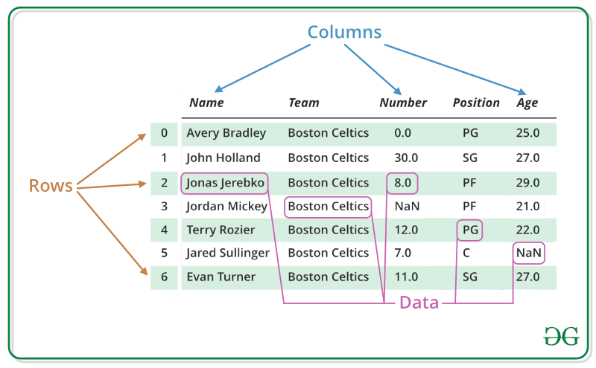
Pandas
Pandas DataFrame is two-dimensional size-mutable, potentially heterogeneous tabular data structure with labeled axes (rows and columns)
A Data frame is a two-dimensional data structure, i.e., data is aligned in a tabular fashion in rows and columns.
Pandas DataFrame consists of three principal components, the data, rows, and columns.

Slide 10
Thank You

